Slide 1
Density, Thermal Conductivity and
Thermal Diffusivity
De
How Much Energy? ----→ Enthalpy, Heat Capacity
How Fast Energy is transferred?
Thermal conductivity k
Thermal Diffusivity
Volumetric Specific
Heat J/m³K

Slide 2
How Heat Transfer is calculated ?
Conduction in a slab
k
d
x
What are A and x ?
What is k ?
What is the temperature gradient and why we use the negative sign ?
Why the temperature profile is linear ?
What is assumed to get a linear temperature profile ?
Is the temperature profile always linear ?
What effect does k have on the temperature gradient ?
Can we get an equation to calculate Q as a function of temperatures and and the geometry of the system ?

Slide 3
How Heat Transfer is calculated ?
Conduction in a slab
k
d
x

Slide 4
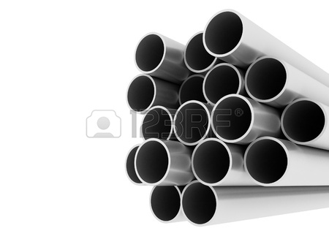
How Heat Transfer is calculated ?
Conduction in a cylinder
r₁
r₂
Is the temperature profile linear ?
Can we get an equation to calculate Q as a function of temperatures and , and the geometry of the system ?
What is L?

Slide 5
Density and porosity of foods and
biomaterials above and below freezing

Slide 6
Density and porosity of foods and biomaterials above and below freezing
Density is used to calculate the thermal diffusivity, the value of the density to be used depends on the porosity
Density and porosity values are required to
calculate the composition of foods in terms
of the volume fractions, as opposed to mass fractions

Slide 7
Density and porosity of foods and biomaterials above and below freezing
Non-Porous Materials

Slide 8
Density and Porosity of Foods above and below freezing
Porous Foods
Volume fraction
of i^{th} solid or liquid
component

Slide 9
Density and Porosity of Foods
above and below freezing
Materials porous or non-porous in bulk
Volume fraction
of i^{th} solid or liquid
component

Slide 10
Thermal Conductivity

Slide 11
Thermal Conductivity
Function of Temperature
Function of Composition
Function of Material Structure

Slide 12
Heat
Layered Structure
Heat
Heat
Heat
Fibrous Structure
Random Structure

Slide 13
Prediction of Thermal Conductivity
Series Model

Slide 14
Prediction of Thermal Conductivity
Parallel Model

Slide 15
Prediction of Thermal Conductivity
Random Structure
Effective Medium Theory (EMT)
(no structure is defined)

Slide 16
Prediction of Thermal Conductivity for two
components- Effective Medium Theory (EMT)

Slide 17
Prediction of Thermal Conductivity
For two components
Layered Structure
Fibrous Structure

Slide 18
Prediction of Thermal Conductivity
for two components
Random Structure
Maxwell-Eucken Equation
Good equation for
frozen materials

Slide 19
What equation to use ?
EMT Equation does not assume a structure
Series and Parallel Model assume conservative (low)
and maximum values
It is necessary to identify food structure
Identify the direction of heat flow relative to the structure
Complex Equations with many components
Carry out a hierarchy of calculations, a each level in the hierarchy, only a part of the food, consisting of two components, is considered. The two components are a disperse (d) and a continuous phase (c)

Slide 20
Example
Calculate the Thermal Conductivity of
Celery at 75ºC
Water
Fibers–Solids-non-Fat (SNF)
Pores (Air)

Slide 21
Calculate the Thermal Conductivity of
Celery at 75ºC
Celery
Water
SNF
Air
Air bubbles (pores) dispersed in a continuous phase which itself consists of parallel SNF fibers (dispersed phase) immersed in water (continuous phase)
Mass Fractions
Volume Fractions

Slide 22
Calculations Hierarchy
(continuous phase)
(dispersed phase)
(dispersed phase)
Level 1
(continuous phase)
Level 2

Slide 23
Level 1 (Fibrous Structure – SNF and water)
We have to use volume Fractions!
Data (from Table 3)
Proximate Analysis of Foods (Table 1)
Celery is not there!!!
Let’s assume 80% of water (w/w), SNF? And air?
X_{w}=0.8
x_{SNF}=0.2
Let’ assume 18% air

Slide 24
Level 1 Calculations

Slide 25
Level 2 Calculations
(continuous phase)
(dispersed phase)
(dispersed phase)
Level 1
(continuous phase)
Level 2

Slide 26
Level 2 Calculations
Water + Fibers + AIR
There will be changes in density
and the volume fraction of each
component
0.18 Assumed
So we need to calculate the new volume fractions based on the air considered in the second level

Slide 27
Level 2 Final Calculations
Maxwell-Eucken Equation
EMT-Equation
Try the Series and the Parallel model
0.114 and 0.497

Slide 28
